Slide 1
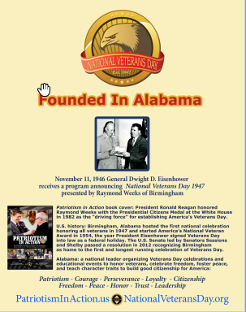
America’s National Veterans Day ”Founded in Alabama; Born in Birmingham” 7 Points for our History, Character Education, and National Branding

Slide 2
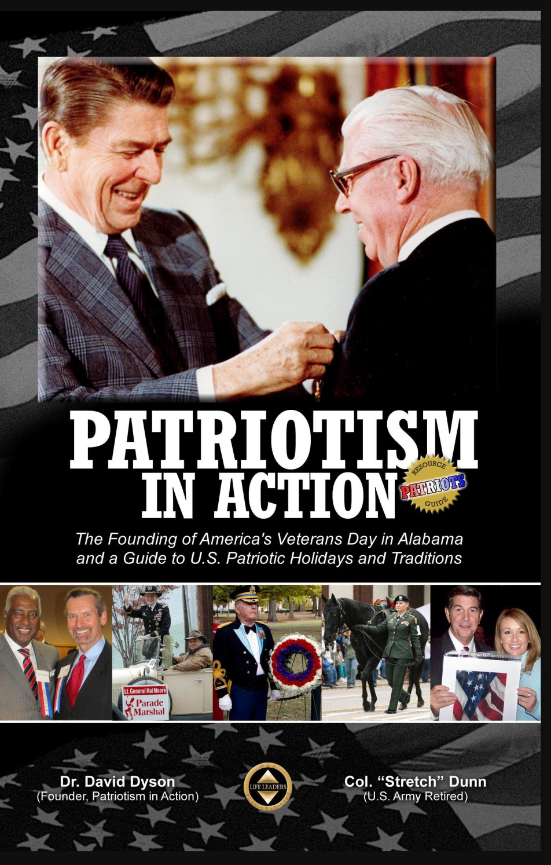
5 Character Traits of Alabama illuminated by the Veterans Day and Civil Rights Movements
Patriotism
Courage
Perseverance
Loyalty
Citizenship
1995: Alabama identified character traits to teach at least 10 minutes daily.
Source: Patriotism in Action

Slide 3
5 more Character Traits & Values illuminated by history of Veterans Day & Rights Recommended by Life Leaders for Students & State Branding
Freedom
Peace
Honor
Trust
Leadership
Source: Patriotism in Action

Slide 4
Veterans Day National Movement Started in Alabama—7 Historical Events
1945: WWII ended. As November 11 approached, Raymond Weeks and others thought the USA should honor veterans of ALL wars (not just WWI).
1946: Raymond Weeks of Alabama took action--planned the celebration, led a delegation to the Pentagon, and gained support from General Dwight Eisenhower for “National Veterans Day 1947” to launch the next Nov. 11.
1947: Birmingham hosted the first Veterans Day with the World Peace Dinner (WWII Hero Gen. Omar Bradley speaking), Memorial Service, Parade….
1954: Birmingham created and presented the National Veteran Award.
1982: Pres. Reagan presented “Raymond Weeks of Birmingham” the Presidential Citizens Medal on national TV as the “driving force” ….
2006: Events added Tribute to the Founder of Veterans Day by Patriotism in Action at the Weeks Monument placed in Linn Park by “a grateful nation.”
2012: U.S. Senate affirmed Weeks-Birmingham-Alabama for starting Veterans Day in a resolution proposed by Patriotism in Action of Life Leaders.

Slide 5
Raymond Weeks of Birmingham, Alabama gained support from General Eisenhower Nov. 11, 1946 The draft program Weeks presented November 11, 1946: “National Veterans Day 1947”

Slide 6
Telegram from GEN Eisenhower 11-11-47
Highlights:
Your World Peace Dinner demonstrates …
peace is something to be secured and perpetuated by thought and work and sacrifice.…
I wish you every success in your purpose of arousing all American citizens…to achieve the greatest of all goals… enduring peace.
Dwight D. Eisenhower

Slide 7
1947: “Uncle Sam” at the first National Veterans Day parade in Birmingham
United Nations (UN) flags were carried by native sons of UN countries or Boy Scouts.
World Peace Dinner speaker: Gen. Omar Bradley, invited by Gen. Eisenhower.
National support from military and media.

Slide 8
Weeks Persevered 1945-54 (9 Years) until Veterans Day was federal law
Character trait: “Perseverance”
President Eisenhower signed into law in 1954 the Act proclaiming November 11 as Veterans Day (Public Law 83-380 signed June 1).
That year, National Veterans Day in Birmingham created the National Veteran Award and Banquet and moved the World Peace Dinner to a luncheon.

Slide 9
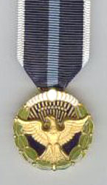
President Reagan honored Raymond Weeks as the “Driving Force” for America’s Veterans Day in 1982
President Reagan pins the Presidential Citizens Medal on Raymond Weeks,
November 11, 1982 (nominated by LTC Glenn Nivens, USA Ret, and briefing for Pres. Reagan by Elizabeth Dole).
President Reagan speaks at the White House on national TV
“We are here to honor an American patriot, Raymond Weeks of Birmingham, Alabama”….the “driving force” establishing America’s Veterans Day.
Life Leaders obtained the speech from the White House so veterans and teachers can use it—see web site or LifeLeaders.tv

Slide 10
Birmingham started and has hosted the National Veteran Award since ‘54
Magazine ad
published for millions of readers telling:
Birmingham is a national leader for Veterans Day, Human Rights, Freedom, and Patriotism.
Sponsored by
FreedomLives.org
LifeLeaders.us

Slide 11
2003—Official Legacy Lost
The U.S. Congress passed a resolution proposed by a representative from Kansas that Veterans Day was founded in Kansas (claimed they had the idea in 1953—7 years after Weeks and Alabama started).
Birmingham had “won the war” on events but “lost the war” on education of “who and where” of Veterans Day history. Only an estimated 1% of Americans knew our nation’s Veterans Day started in Alabama because this history had not been taught in most schools.
We can fix this with lessons and standards to teach this national history.
What can you do to make sure your school, veteran organization, and tourism office knows and teaches this national history this year? Before the World Games 2021?

Slide 12
November 13, 2012
Official US Legacy Restored for Weeks, Birmingham, and Alabama.
U.S. Senate Resolution passed affirming Birmingham, Alabama, and Mr. Weeks as “driving force” of America’s National Veterans Day
“…the first Veterans Day was held in Birmingham, Nov 10-11, 1947.”
---------
Patriotism in Action proposed the U.S. resolution to restore the history and legacy of Raymond Weeks, Birmingham, and Alabama. Senator Jeff Sessions led this proposal to the Senate, in cooperation with Kansas, who deserves credit advancing the movement.

Slide 13
We must implement the resolution to sustain the legacy &
brand Birmingham & AL as leader
We could succeed with posters and books in every school, veteran post/chapter, city hall, and tourism venue, plus teaching lesson plans.

Slide 14
Veterans Day Founding History & Character Education should be taught to every student We started. Now, let’s finish the mission to be a national leader for teacher-student resources.

Slide 15
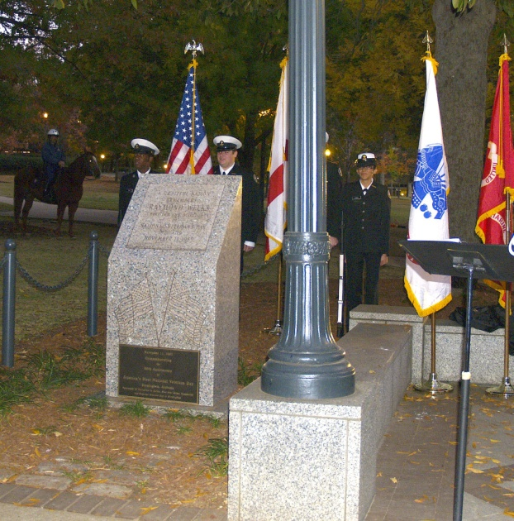
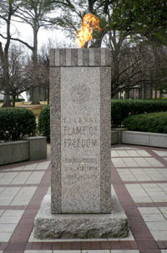
Tribute to the Founder of Veterans Day Since 2006. No Charge. Students, teachers, parents invited.
Patriotism in Action Tribute
November 10, 4:30-5 p.m.
Weeks Monument, Linn Park, across from Boutwell
Color Guard, Horses, Music, national guests….
and see
The Eternal Flame of Freedom
in view of the monument just across Linn Park
Followed by
National Veteran Award Reception/Banquet

Slide 16
Personal Leadership for Patriots Since “911” 2001. Veterans, students, teachers, parents invited.
Thursday before Veterans Day at the Southern Museum of Flight, Birmingham.
Music, color guard, refreshments, see museum planes, message about Personal Leadership for Patriots….

Slide 17
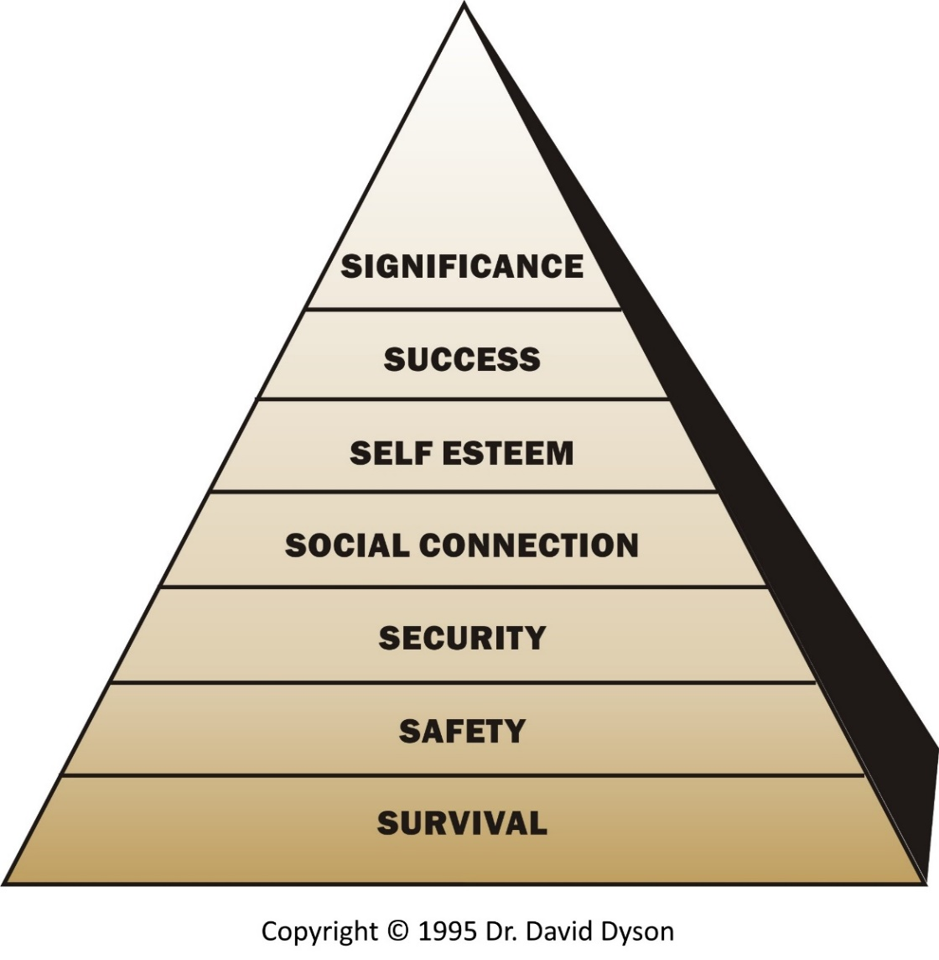
We have Freedom of Liberty, Freedom of Rights, Freedom to Flourish. Let’s teach this inspiring history of hope, how to flourish, and help students plan for school and life. Students will boost attitude, attendance, and achievement. Schools and our state can boost performance and satisfaction. Dr. David Dyson Life Leaders Institute

Slide 18
Three Freedoms Alabama can advance and brand before the World Games 2021
Freedom of Liberty: Birthplace of National Veterans Day, American Village, Alabama National Cemetery…
Freedom of Rights: Cradle of the Civil Rights Movement, 4 of 10 cities commemorated in “50 Years Forward,” Civil Rights Institute…
Freedom to Flourish: Plan for School and Life Movement started…

Slide 19
Action
Consider what you have learned and what the character traits mean to you, then write a sentence describing your best-self fulfilling each trait:
Patriotism
Courage
Perseverance
Loyalty
Citizenship

Slide 20
Action
Consider what you have learned and what the character traits mean to you, then write a sentence describing your best-self fulfilling each trait:
Freedom
Peace
Honor
Trust
Leadership

Slide 21
Action
Samples statements read by students
Consider/discuss how vision statements for character traits are part of your “Constitution” to guide you
Add your notes written today to a word processing document to help you improve
Improve your vision sentences for the character traits describing how you desire to fulfill them
Share your draft with a parent, advisor, or mentor to get feedback for how your statements fit you
Turn in your Character Vision Statements ___________

Slide 22
Discussion Questions
How are written plans with your mission, vision for character traits, and strategies to lead your life similar in purpose for you as your “Constitution” to guide you as does the Constitution for the country?
Thousands had the idea after WWII that Veterans Day should replace and expand Armistice Day to honor veterans of all wars--what did Raymond Weeks do differently? What character traits did he apply? How could you apply them to your big goals?
Why were the “driving force” leadership of Weeks and the position leadership of Eisenhower need to succeed?

Slide 23
www.LifeLeaders.Education (landing page for teachers with links to resources) More resources to be added: Poster summarizing history, listing character traits Book telling founding history and 10 character traits Video of President Reagan honoring Weeks and speech www.LifeLeadersInstitute.org (see Programs and Veterans Day Ed)

Slide 24
We are adding resources you can use for 7 callings: 1. Best-Self Leadership 2. Plan for School and Life 3. Master Your Goliaths 4. Patriotism in Action 5. Veterans Day History and Character Education 6. Freedom to Flourish 7. Farm and Ranch for Animals, Plants, People If you have requests or recommendations: David@LifeLeadersInstitute.org 205.670.1733 or 205.422.6484

